Slide 1
Sentiment Analysis and Aggregation of Stock Market Opinions

Slide 2
Outline
Introduction and Problem Definition
Modules
Data Collection
Data Preprocessing and Filtering
Sentiment Analysis
Aggregation
Learning Phase
Presentation
Conclusion
Future Scope

Slide 3
Introduction and Problem Definition
Current Scenario:
People wanting to invest in the stock market are always looking for reliable market predictions made by experts to gain profits.
These experts often use blogs or social networking platforms to express their views about the current trends in the market.
The people looking to invest in any particular stock search the web for predictions by experts on that particular stock to gauge the overall opinion.
These predictions help the people invest their money in the proper place at the proper time.

Slide 4
Introduction and Problem Definition
Problem Statement:
In online communities about finance, different users with different levels of expertise write about their view of the current market scenario and suggest areas or companies for others to invest in.
But it is practically impossible for any other user, naive or expert, to go through all the opinions expressed on distributed across a site.
This project aims to present market predictions in various sectors, collected from twitter, in a consolidated manner.

Slide 5
Introduction and Problem Definition
Motivation:
Recent years have a witnessed a rise in the number of online financial communities and stock market experts.
Market predictions (even regarding a single company) are dispersed and any person looking for opinions from different experts for a particular company or a sector has to look for them by going through all their posts.
Hence, we attempt to gather the market predictions from such a platform and process it to present the user with an overall opinion regarding the stock of a particular company or a sector.

Slide 6
Introduction and Problem Definition
Methodology and Resources:
Data Collection: First phase would be collecting stock market opinions of expert market predictors from twitter. We are using the twitter PHP API and PHP libraries for implementing this phase.
Filter Phase: In the Second phase, we would process the data to bring it into the pre-defined format and mapping of opinions (tweets) to company names and sector names. This phase also involves discarding of irrelevant tweets. We are using PHP for filtering of tweets.

Slide 7
Introduction and Problem Definition
Methodology and Resources:
Sentiment Analysis Phase: The third phase consists of analyzing each individual opinion and extracting the buy or sell sentiment from it. We are using python for sentiment analysis.
Aggregation/Consolidation: As the opinions could be from people with different levels of expertise, we cannot assign the same weight to each opinion. We need to distinguish the predictors to decide their credibility.

Slide 8
Introduction and Problem Definition
Methodology and Resources:
Learning Phase: This phase involves addition of new feature words to the dictionary, adjustment of feature weights, modification of the Analyst’s rating depending upon past performance.
Presentation: The last phase is a pictorial presentation of the aggregated opinion about a particular stock or sector using web-based graphs and charts

Slide 9
Introduction and Problem Definition
Target Output:
The user can submit a query for any company or a particular sector. The output would be represented in the pictorial form in the following ways:
Bar chart depicting current company status
Line graph showing company trends over a period of time
Pie charts demonstrating the best buys/sells for the day
Aggregate opinion of each stock market predictor
The person can then decide on the basis of the output whether he or she should invest in a particular company or sector.

Slide 10
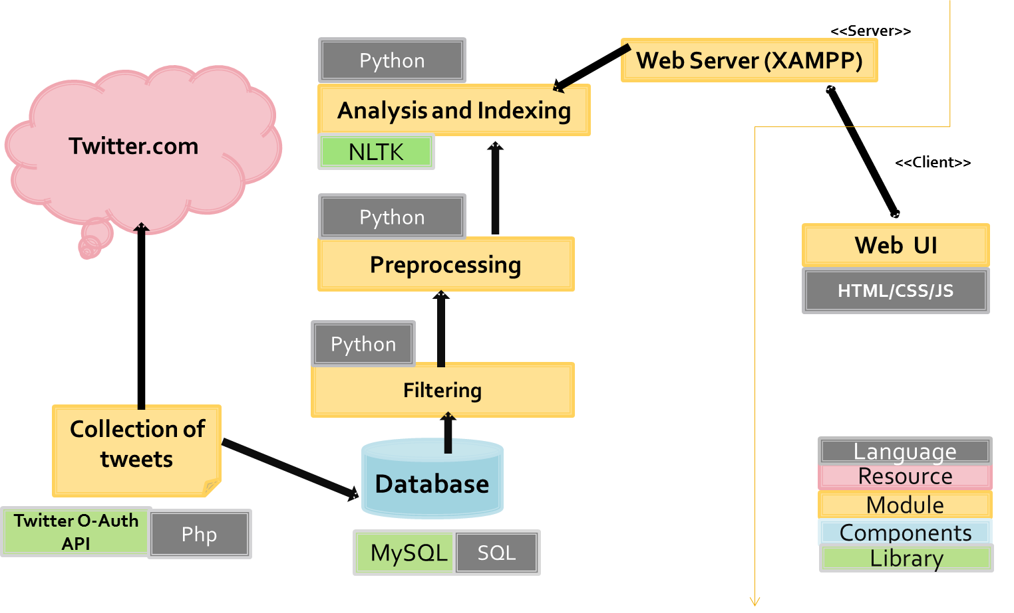
Architecture

Slide 11
Data Collection
Micro-blogging data is readily available at low cost permitting a faster and less expensive creation of indicators, compared to traditional sources (e.g. large-scale surveys).
The small size of the message (maximum 140 characters) and the usage of hash-tags can make it a less noisy source of data.
Users post very frequently, reacting to events in real time. This regularity allows a real-time sentiment assessment.
Twitter is selected as a source of micro-blogging data since it is by far the most popular service and also because their API enables the collection of a large number of messages. Tweets are collected daily by using the Twitter REST API and messages are filtered by the company identifiers.

Slide 12
Data Preprocessing and Filtering
The filtering module checks for a company or a commodity name in the tweets. If none of them is found, the tweets are discarded.
The data extracted from twitter has to be pre-processed for it to be in a generalized format. This is done by removing the stop-words, numbers and special symbols.
The remaining words are checked to see if they are keywords (names of companies or sectors) and need to be indexed.

Slide 13
Data Preprocessing and Filtering
During this stage unwanted contents is removed.
These steps were followed:
Removing stop-words (e.g. a, an , the)
Removing URLs
Remove Special Symbols like #,%,&, emoticons , *etc.
Remove punctuation.
Remove extra white spaces
Convert to Lower case

Slide 14
Sentiment Analysis
Sentiment Detection
Sentiment detection requires appraising and extracting opinions from the textual dataset through the use of computational tasks.
Each sentence is examined for subjectivity. Using techniques such as:
- Unigrams: This is a classic approach where each element is represented as a feature vector based on frequency of a single word. It is often described as a bag of words approach.
- N-Grams: In this approach the features of a document is represented by multiple words in sequence (e.g.: words in pairs, triplets) which captures more context.

Slide 15
Sentiment Analysis
Lemmas: This involves the use of synonyms rather than the literal word. For example: better, good, and best. This method reportedly makes the classification task easier as well as facilitates generalization.
Negation: This is basically an extension to the n-gram methods where the phrases “I like this book” and “I do not like this book” would have considered similar under most classification techniques, but with negation, both terms are forced into opposite groupings.
- Opinion words: These are basically words that are used to describe people feelings and opinions (nouns, verbs, adjectives, adverbs). These words are good indicators of subjectivity in a document.

Slide 16
Sentiment Analysis
Sentiment Classification
Polarity classification classifies each subjective sentence in the textual dataset into classification groups. Usually these groups are represented on two extreme points on a continuum (positive, negative). However, classification can also involve multiple points similar to the star ratings used by hotels, restaurants and retailers.
A wide variety of machine learning techniques are used in binary and polar classification. The basic functions available for classification include: Naive Bayes (NB), Support Vector Machines (SVM) and Maximum- Entropy (ME).

Slide 17
Sentiment Analysis
A Naive Bayes classifier is a probabilistic classifier based on applying Bayes’ theorem assuming that features are independent given the class label. This classifier is constructed based on the frequency of occurrence of each feature per class in the training data set.
Under ME a number of models are constructed where each feature correspond to a constraint on the model. The model with the maximum entropy over all models is selected for classification.
Although all these classifiers are validated in the literature, they require pre-tagged training data or a data corpus which is not always available, or will take a considerable amount of resources both in terms of time and human resources to build.

Slide 18
Sentiment Analysis
Bag-of-Features Framework
To implement these algorithms for sentiment analysis, a standard bag-of-features framework can be used.
Let {f1 ,…….,fm } be a predefined set of m features that can appear in a document; examples include unigrams such as ‘buy, sell, rising, falling, profit, loss, increase, decrease, etc’ or bigrams such as ‘high risk', 'low risk', etc.
Let n_{i}(d) be the number of times f_{i} occurs in document d.
Then, each document d is represented by the document vector: (n1(d), n2(d),……….,nm(d)).
Each data item can then be scanned for the presence and count of these feature words.

Slide 19
Sentiment Analysis
Supervised Machine Learning Algorithms:
Naive Bayes algorithm
The Bayesian Classification represents a supervised learning method as well as a statistical method for classification. Assumes an underlying probabilistic model and it allows us to capture uncertainty about the model in a principled way by determining probabilities of the outcomes.
Bayesian classification provides practical learning algorithms and prior knowledge and observed data can be combined.
One approach to text classification is to assign to a given document d the
class c = arg maxc P(c | d).

Slide 20
Sentiment Analysis
Supervised Machine Learning Algorithms:
Naive Bayes algorithm
The Naive Bayes (NB) classifier can be derived by first observing Bayes' rule,
P(c | d) = P(c) * P(d | c) / P(d)
where P(d) plays no role in selecting c.
To estimate the term P(d | c), Naive Bayes decomposes it by assuming the f_{i}'s are conditionally independent given d's class:
In above equation, f represents a feature and n(d) represents the count of feature fi found in tweet d. There are a total of m features.

Slide 21

Sentiment Analysis
Supervised Machine Learning Algorithms:
Naive Bayes algorithm
In above equation, f represents a feature and n(d) represents the count of feature f_{i} found in tweet d. There are a total of m features.

Slide 22
Sentiment Analysis
Supervised Machine Learning Algorithms:
Types of Naïve Bayes classifiers:
Multinomial Naive Bayes is a specialized version of Naive Bayes that explicitly models the word counts and compared to simple naive Bayes that models a document as the presence and absence of particular words.
Bernoulli Naive Bayes implements the naive Bayes training and classification according to multivariate Bernoulli distributions; i.e., features are assumed to be binary-valued (boolean) variables.
The decision rule for Bernoulli naive Bayes differs from multinomial NB’s rule in that it explicitly penalizes the non-occurrence of a feature that is an indicator for class.

Slide 23
Sentiment Analysis
Supervised Machine Learning Algorithms:
Maximum Entropy algorithm
The motivating idea behind maximum entropy is that one should prefer the most uniform models that also satisfy any given constraints.
We use the training data to set constraints on the conditional distribution. Each constraint expresses a characteristic of the training data that should also be present in the learned distribution.
Maximum entropy allows us to restrict the model distribution to have the same expected value for this feature as seen in the training data.

Slide 24
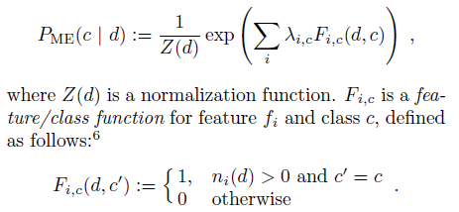
Sentiment Analysis
Supervised Machine Learning Algorithms:
Maximum Entropy algorithm
Compared to Naive Bayes, here the estimate of P(c | d) takes the following exponential form:
The lambda values are feature-weight parameters; inspection of the definition of PME shows that a large lambda value for a given feature fi means that fi is considered a strong indicator for class c.

Slide 25
Sentiment Analysis
Supervised Machine Learning Algorithms:
Maximum Entropy algorithm
A particular feature/class function might fire if and only if a given bigram appears and the document's sentiment is hypothesized to be negative.
Unlike Naive Bayes, Maximum Entropy makes no assumptions about the relationships between features and is thus used when we don’t know anything about the prior distributions and when it is unsafe to make any such assumptions.

Slide 26
Sentiment Analysis
Unsupervised Machine Learning Algorithms:
Point-wise Mutual Information (PMI)
PMI performs classification based on some fixed syntactic phrases that are likely to be used to express opinions. The algorithm consists of three steps:
Step 1: It extracts phrases containing adjectives or adverbs as they are good indicators of subjectivity and opinions. The algorithm extracts two consecutive words, where one member of the pair is an adjective/adverb and the other is a context word.

Slide 27

Sentiment Analysis
Unsupervised Machine Learning Algorithms:
Step 2: It estimates the orientation of the extracted phrases using the point-wise mutual information (PMI) measure given in Equation below:
Here, Pr(term1 ∧ term2) is the co-occurrence probability of term1 and term2, and Pr(term1)Pr(term2) gives the probability that the two terms co-occur if they are statistically independent.

Slide 28
Sentiment Analysis
Unsupervised Machine Learning Algorithms:
The ratio between Pr(term1 ∧ term2) and Pr(term1)Pr(term2) is the amount of information that we acquire about the presence of one of the words when we observe the other.
The opinion orientation (oo) of a phrase is computed based on its association with the positive reference word “excellent” and its association with the negative reference word “poor”:
oo(phrase) = PMI(phrase, “excellent”) − PMI(phrase, “poor”)
The probabilities are calculated by issuing queries to a search engine and collecting the number of hits. Thus, by searching the two terms together and separately, we can estimate the probabilities in the equation.

Slide 29
Sentiment Analysis
Unsupervised Machine Learning Algorithms:
Summation of feature weights
One approach can be to count the daily total number of words that are considered positive and negative by a lexical resource such as WordNet. As an example, we add the positivity and negativity score of each word to calculate the overall scores.
A message is considered: positive, if the total positivity score is higher than the total negativity score ; negative, if the total negativity score is higher than the total positivity score; and neutral, if both are equal

Slide 30
Our Approach
Weight-based sentiment classification using a bag-of-words framework
Feature words:
Let {f1 ,…….,fm } be a predefined set of m features that can appear in a data element.
These feature words are specific to the stock market domain; examples include unigrams such as ‘buy, sell, rising, falling, profit, loss, increase, decrease, etc’ or bigrams such as ‘high risk', 'low risk', etc.
Presence of Feature words:
Let n_{i}(d) denote the occurrence of f_{i} in document d.
Thus, n_{i}(d) = 1 if f_{i} occurs in document d.
= 0 otherwise
Each data item is then scanned for the presence of these feature words.

Slide 31
Our Approach
Weight-based sentiment classification using a bag-of-words framework
Feature weighting:
Features are assigned weights in the range [0-1] which is in normalized form. Each feature word is assigned a positive score and a negative score.
Multiplication of feature weights:
The positive weights for feature words in a phrase are multiplied to give the overall positive probability of the phrase. Similar process is carried for calculating the negative probability of the phrase. The higher of the 2 probabilities gives the sentiment for the phrase.

Slide 32
Our Approach
Weight-based sentiment classification using a bag-of-words framework
Δ = 0
For all feature words f_{i}:
If n_{i}(d) = 1:
Δ = Δ + Σ log(f_{i} pos) - Σ log(f_{i} neg)
_{Where}
f_{i} pos => positive score of feature f_{i}
f_{i} neg => negative score of feature f_{i}
If Δ >= 0: classify sentence as positive.
If Δ <= 0: classify sentence as negative.

Slide 33
Our Approach
Weight-based sentiment classification using a bag-of-words framework
Handling Negation:
As “good” and “not very good” indicate opposite sentiment orientations, we added the tag NOT to every word between a negation word (“not”, “isn’t”, “didn’t”, etc.) and the first punctuation mark following the negation word.
If a feature word contains the tag “not”, then the score of the positive or negative word is differenced with “1”.
Handling Sentiment Association for Multiple Entities in a single data item:
The data element is checked for consecutive entities, which if present are grouped together into one super-entity. The text is then scanned again and broken/split into sub-parts whenever an entity or a super-entity is encountered. This process helps us to separate the sentiment-oriented phrases and the entities.

Slide 34
Aggregation
Now we will talk about aggregating and representing sentiment information drawn from a collection of tweets.
Automatic determination of market sentiment, or the majority “leaning” of an entire body of investors, from the individual remarks of those investors is a type of multi-document opinion-oriented summarization.
In this phase, we assign weights to every opinion depending upon following criteria:
Analysts’ rating
Re-tweet count of opinion
Favorite count of opinion

Slide 35
Aggregation
We calculate the following
Buy_probability = Σ (W_{a} x W_{r} x W_{f} ) if sentiment is buy
Sell_probability = Σ (W_{a} x W_{r} x W_{f} ) if sentiment is sell
where
W_{a} – Rating of the Analyst
W_{r} - Retweet count of the opinion
W_{f} - Favorite count of the opinion
The higher of the two probabilities will give the overall sentiment.

Slide 36
Learning Phase
Three variables that change gradually over a period of time as the model learns:
Rating of each analyst
Addition of new feature words to the dictionary
Adjustment of the positive and negative scores of feature words

Slide 37
Learning Phase
Rating of each analyst:
No of companies
Σ
(
)
Performance of analyst for company i
-
Contribution of analyst towards overall opinion for company i
i=1
No. of companies
Where
Performance of analyst for company i
= (No. of True positives – No. of false positives)/ No. of opinions by that analyst for company i
Contribution of analyst towards overall opinion for company i
= No. of opinions by that analyst for company i / Total opinions for the company i

Slide 38
Learning Phase
Addition of new feature words to the dictionary:
Words present in a data item that do not match any of the existing feature words from the feature word dictionary are considered to be potential feature words for future analysis.
Synonyms for these words are obtained using a lexical resource (Wordnet), which are then compared with existing feature words.
If such a word has a synonym that is an existing feature with the same part-of-speech value as the word under consideration, then the new word is added to the feature list.
The part-of-speech check ensures that the new word has the same context as an existing feature.

Slide 39
Learning Phase
Adjustment of the positive and negative scores of feature words:
Where
C = constant (assume 0.01 in our case)
contribution of that feature word to overall sentiment of opinion = 1/(count of feature words in that opinion)
Δ = C x (1 – contribution of that feature word to overall sentiment of opinion)

Slide 40
Analyst Success Ratio
The predictions by the analyst are usually followed by posts which specify that the predicted target has been achieved.
These posts are being used to determine how successful the analyst’s predictions are.
The percentage of the analyst’s successful predictions is calculated and displayed as a line graph over a period of one year.

Slide 41
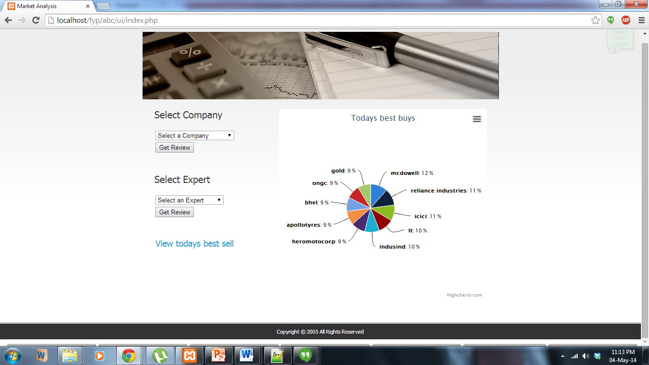
Presentation

Slide 42
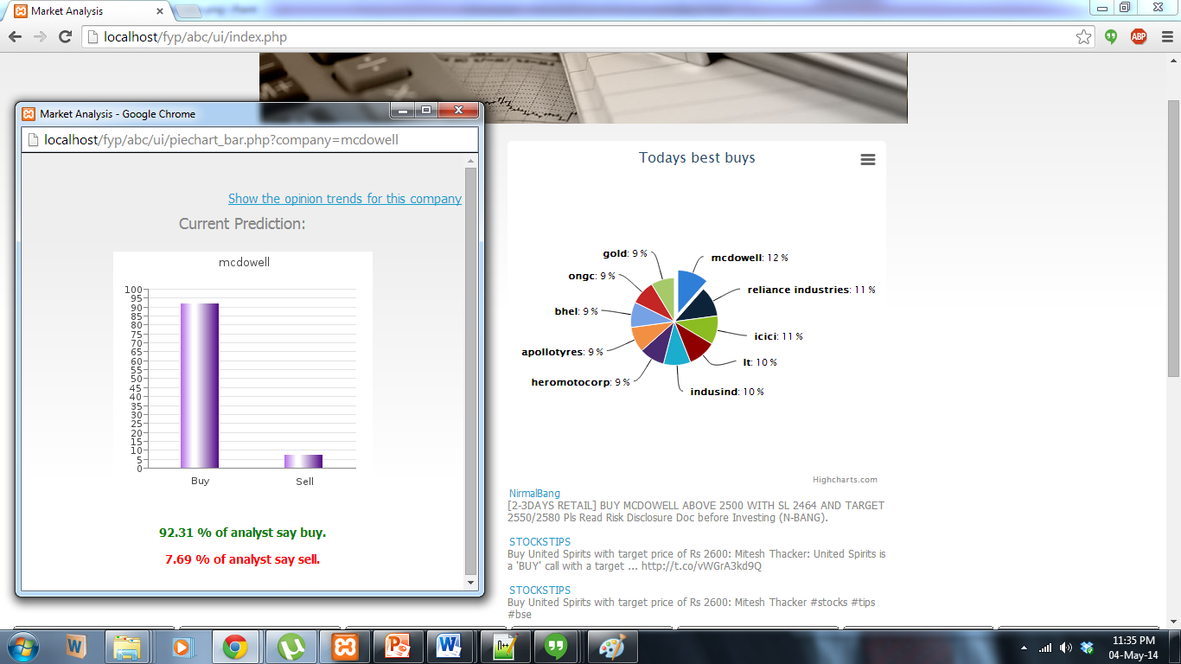
Presentation

Slide 43
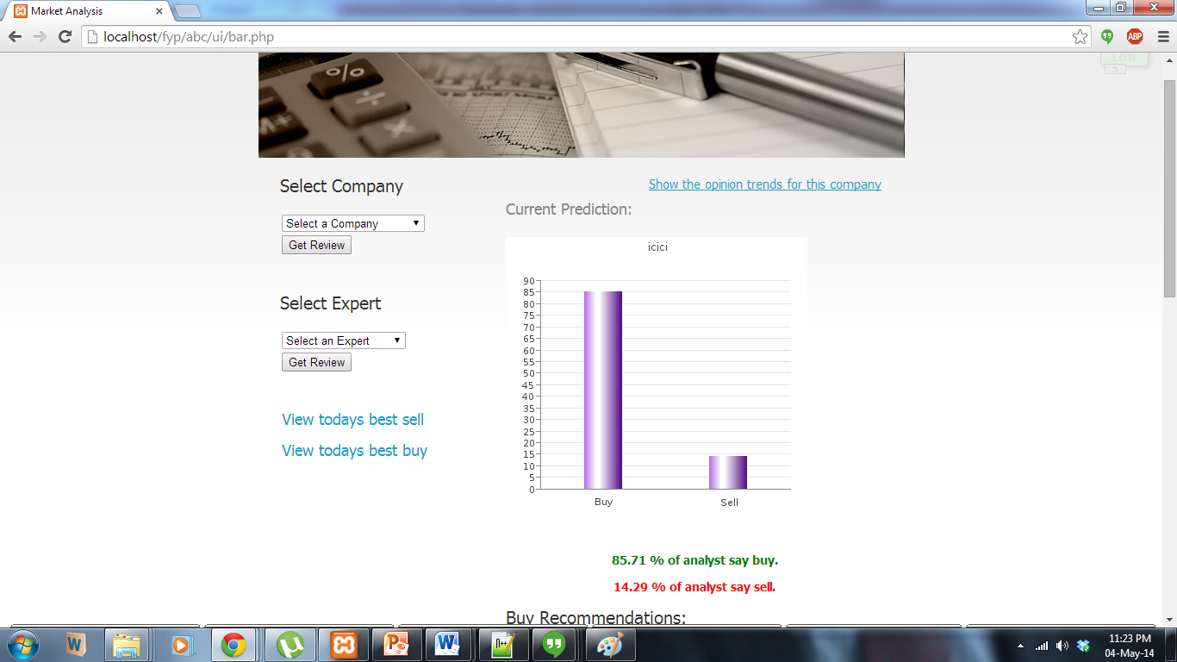
Presentation

Slide 44
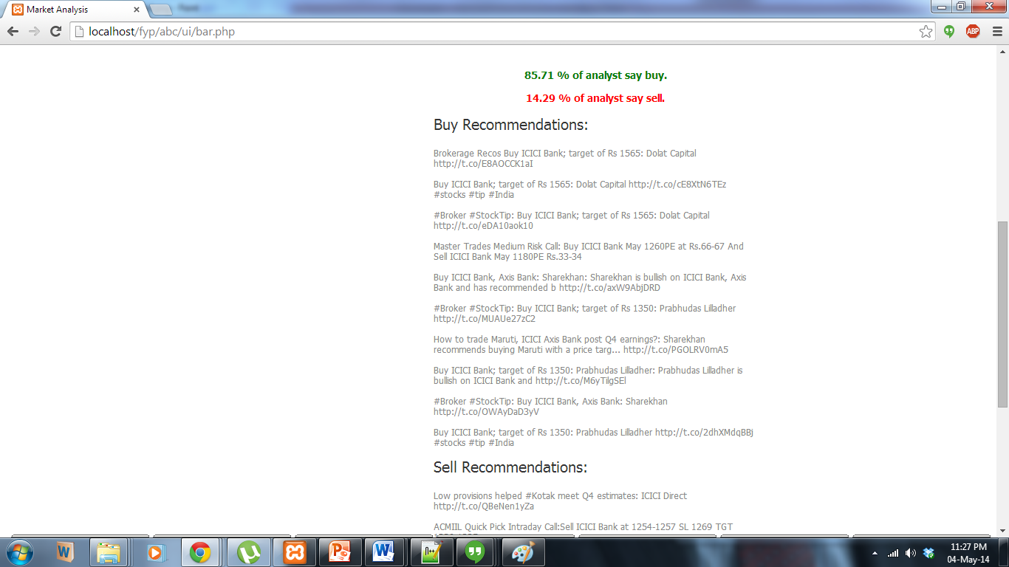
Presentation

Slide 45
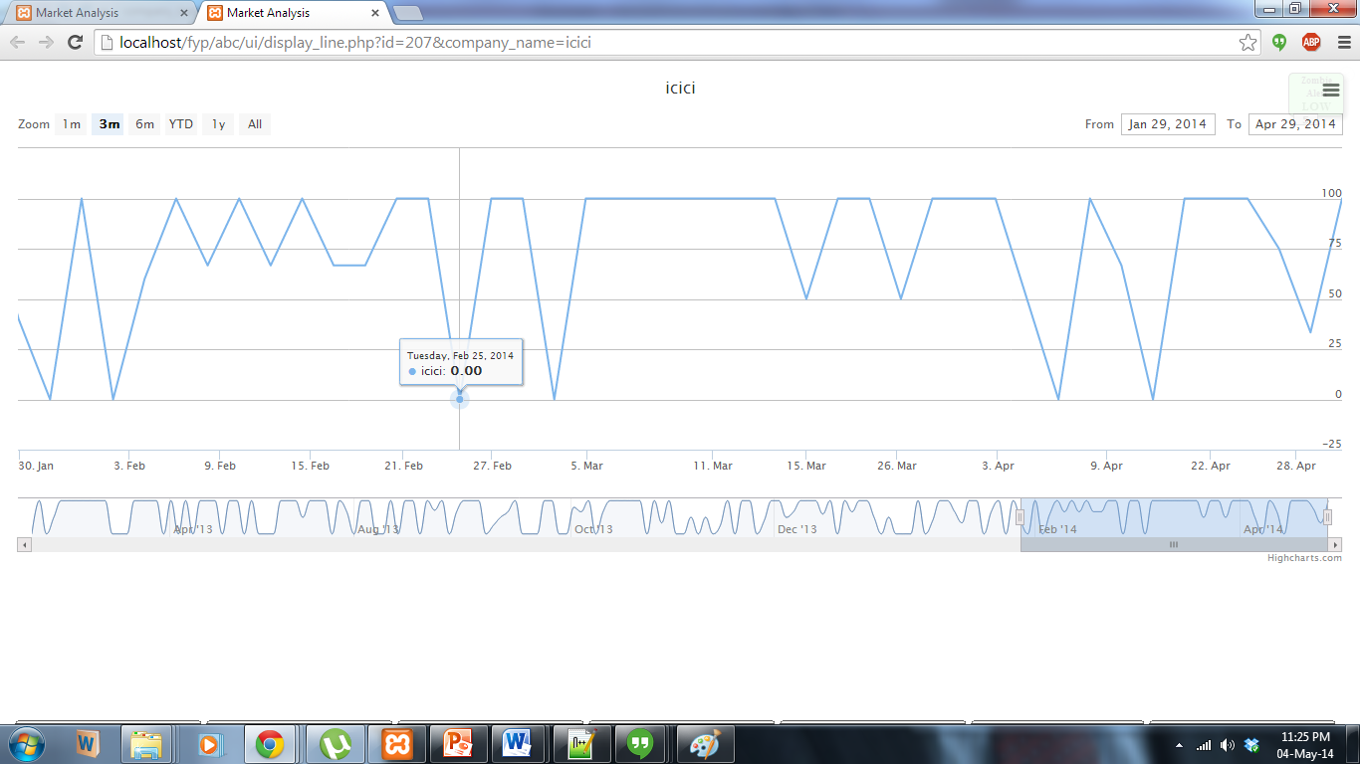
Presentation

Slide 46
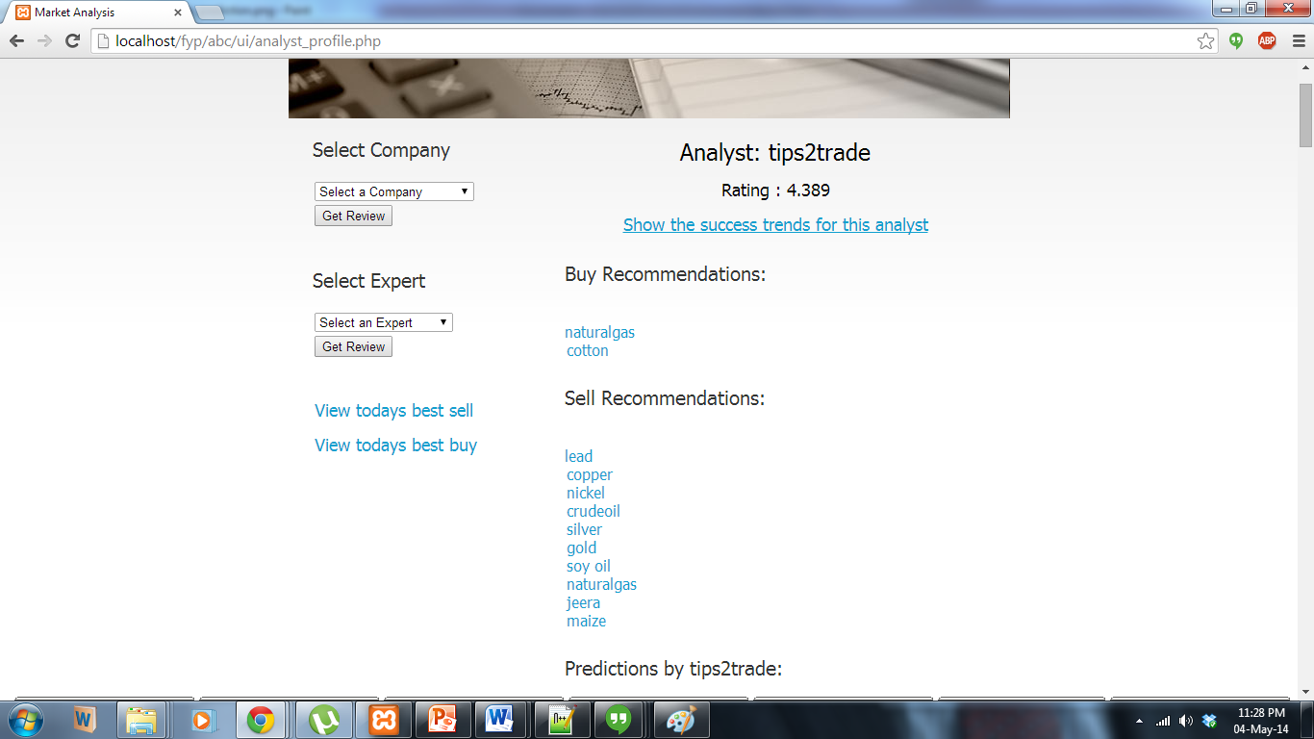
Presentation

Slide 47
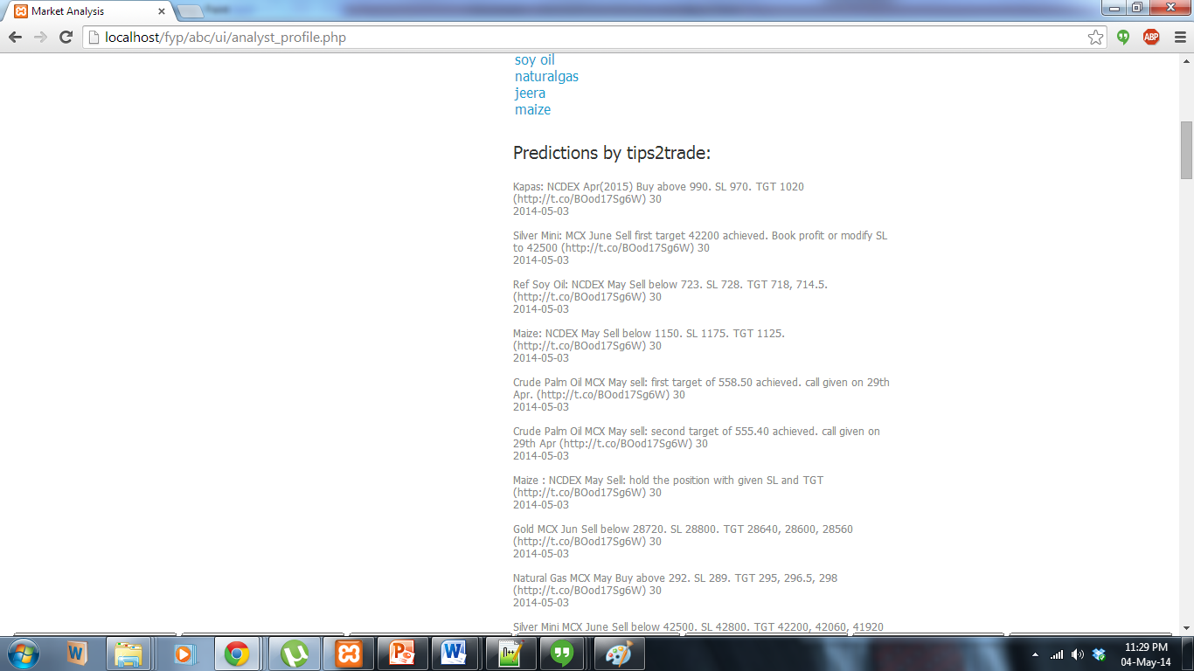
Presentation

Slide 48
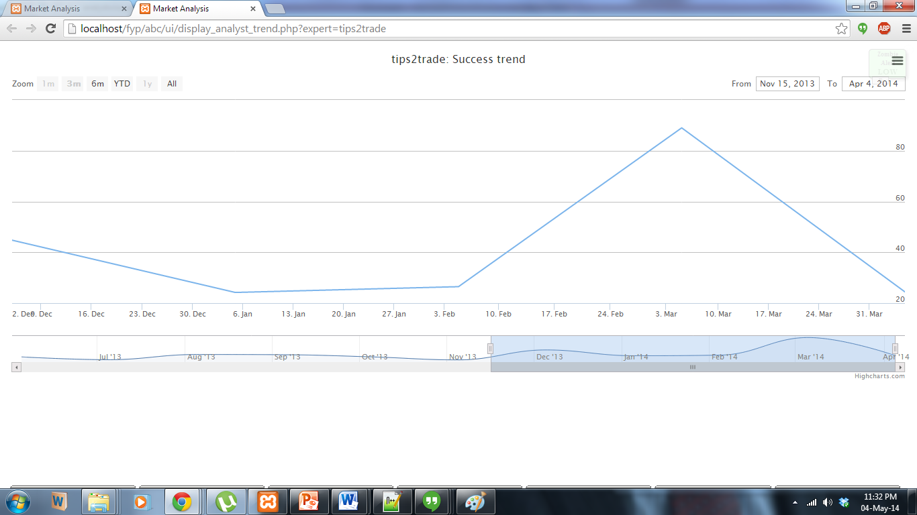
Presentation

Slide 49
Conclusion
We aim to develop an application that presents predictions and opinions collected from twitter about the various sectors of the market in a consolidated manner. People looking to invest in any particular stock can directly access the overall opinion instead of searching the web for predictions by experts on that particular stock.
An aggregate opinion reflecting the current market scenario and suggestions for areas or companies to invest in will save a lot of time for the user and will also provide him/her with reliable information about the market.

Slide 50
Future Scope
Currently, the data set has been collected from Twitter. In the future, data set could be diversified to include more websites and blogs. However this would increase the complexity of pre-processing.
This model could be integrated with an algorithmic trading tool. The predictions made by our model can be used for investing in stocks and increasing profits.
The rating algorithm for the analysts can be improved. This would include comparing the analyst’s predictions with the real world stock market. The model can also take into account the feedback of registered users to rate the analyst.
Also, news articles can be parsed to predict the impact it will have on the stock market.

Slide 51
Thank You!
Contributors:
Project Guide: Prof. V B Nikam
Students: Gayatri Mehendarge 101081049
Jinal Thakkar 101081052
Nidhi Shah 101081018
Sharmin Lalani 101081016

